Slide 1
Digital Hygiene for Individuals and Families
A Daily Place for God in Every Heart and Home
2022–2027
Dwain N. Esmond, Assoc. Dir.
Ellen G. White Estate

Slide 2
Is Digital Media Evil?
Are Devices Evil?

Slide 3
Benefits for Individuals
Connectivity
Community
Education
Information
News
Easy Information Sharing
Support Noble Causes
Stress Reliever and Way to Decrease Loneliness

Slide 4
Benefits for Families
Inexpensive connectivity with family from anywhere at any time.
Stay connected via statuses, share photos and videos.
Can share your problems and feelings in hard times with a geographically separated family member.
Provide an instant source of connection with the family to students and workers abroad.
Efficient source of establishing a friendly atmosphere for family relationships via group chats and events sharing.

Slide 5
Time well Spent?
The Average Social Media user spent 2 hours and 27 minutes per day on social media in 2022.
50.1% of the time spent on mobile was done using social media apps in 2020.

Slide 6
Average Screen Time
Globally, the average screen time is 6 hours 58 minutes/day.
The average American spends 7 hours and 4 minutes staring at a screen/day.
Americans spend an average of 3 hours and 43 minutes on their phone/day.
Experts recommend less than 2 hours of screen time/day.
Daily screen time peaked at 7.7 hours daily during the COVID-19 Pandemic.—Zippia Research

Slide 7
Negatives for Individuals
SHORTENED ATTENTION SPAN
MEMORY LOSS
FRACTURED THINKING
LOSS OF EMPATHY
META-AWARENESS
NEGATIVE ATTITUDE
DECLINE OF HEALTH

Slide 8
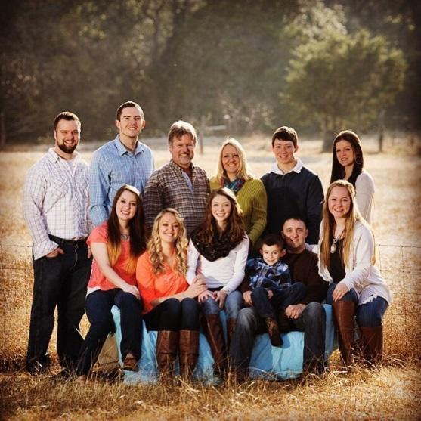
Negatives for Families
Changed Family Culture - less family gatherings
Increased Isolation of family members
Changed Marital Relationships –present but emotionally absent
Decrease in Family Importance – decreases dependence on parents, and bond with parents
Others Get the Best of us, family gets the rest of us
This Photo by Unknown Author is licensed under CC BY-SA-NC

Slide 9
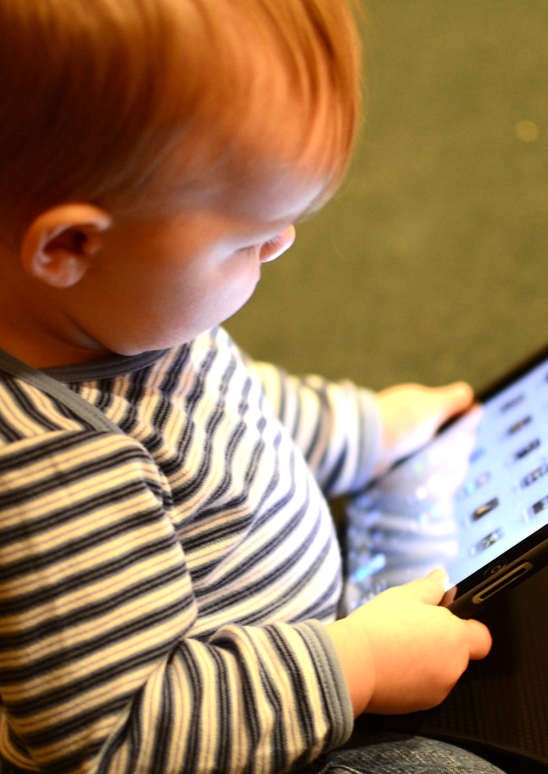
Negatives for Children
Negatively affects child psychology, deteriorating memory function
Reduces sleep cycles, limits creativity
Diminishes communication between parent and child, shortens attention spans
Potentially encourages violent and aggressive behavior
Premature thinning of Cortex (7 Hrs. or more/day)
2 hrs. or more/day—score lower on thinking and language tests
This Photo by Unknown Author is licensed under CC BY

Slide 10
In this house…
Technology is a privilege not a right
All technology must be parent approved
We value people more than technology
Devices don't come to the dinner table
There is no tech behind closed doors
Chores and homework come before tv or video games
Turn it off negotiation Is not a negotiation
We break it we help pay to replace it
We use technology appropriately
… or we lose it
Source: sunshineandhurricanes.com
9 Rules for Technology Use in Every Family

Slide 12
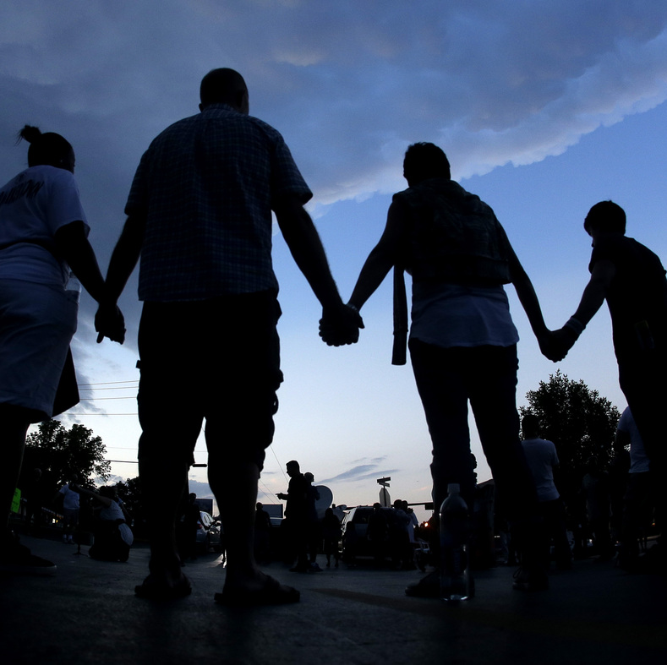
Why We Must Do This (Ephesians 2:1-10)
“And you He made alive, who were dead in trespasses and sins, in which you once walked according to the course of this world, according to the prince of the power of the air, the spirit who now works in the sons of disobedience, among whom also we all once conducted ourselves in the lusts of our flesh, fulfilling the desires of the flesh and of the mind, and were by nature children of wrath, just as the others.
This Photo by Unknown Author is licensed under CC BY-NC-ND

Slide 13
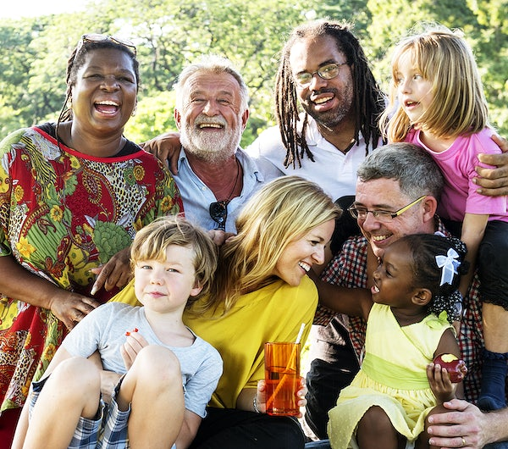
Why We Must Do This (Ephesians 2:1-10)
“But God, who is rich in mercy, because of His great love with which He loved us, even when we were dead in trespasses, made us alive together with Christ (by grace you have been saved), and raised us up together, and made us sit together in the heavenly places in Christ Jesus, that in the ages to come He might show the exceeding riches of His grace in His kindness toward us in Christ Jesus. For by grace you have been saved through faith, and that not of yourselves; it is the gift of God, not of works, lest anyone should boast. For we are His workmanship, created in Christ Jesus for good works, which God prepared beforehand that we should walk in them.

Slide 14
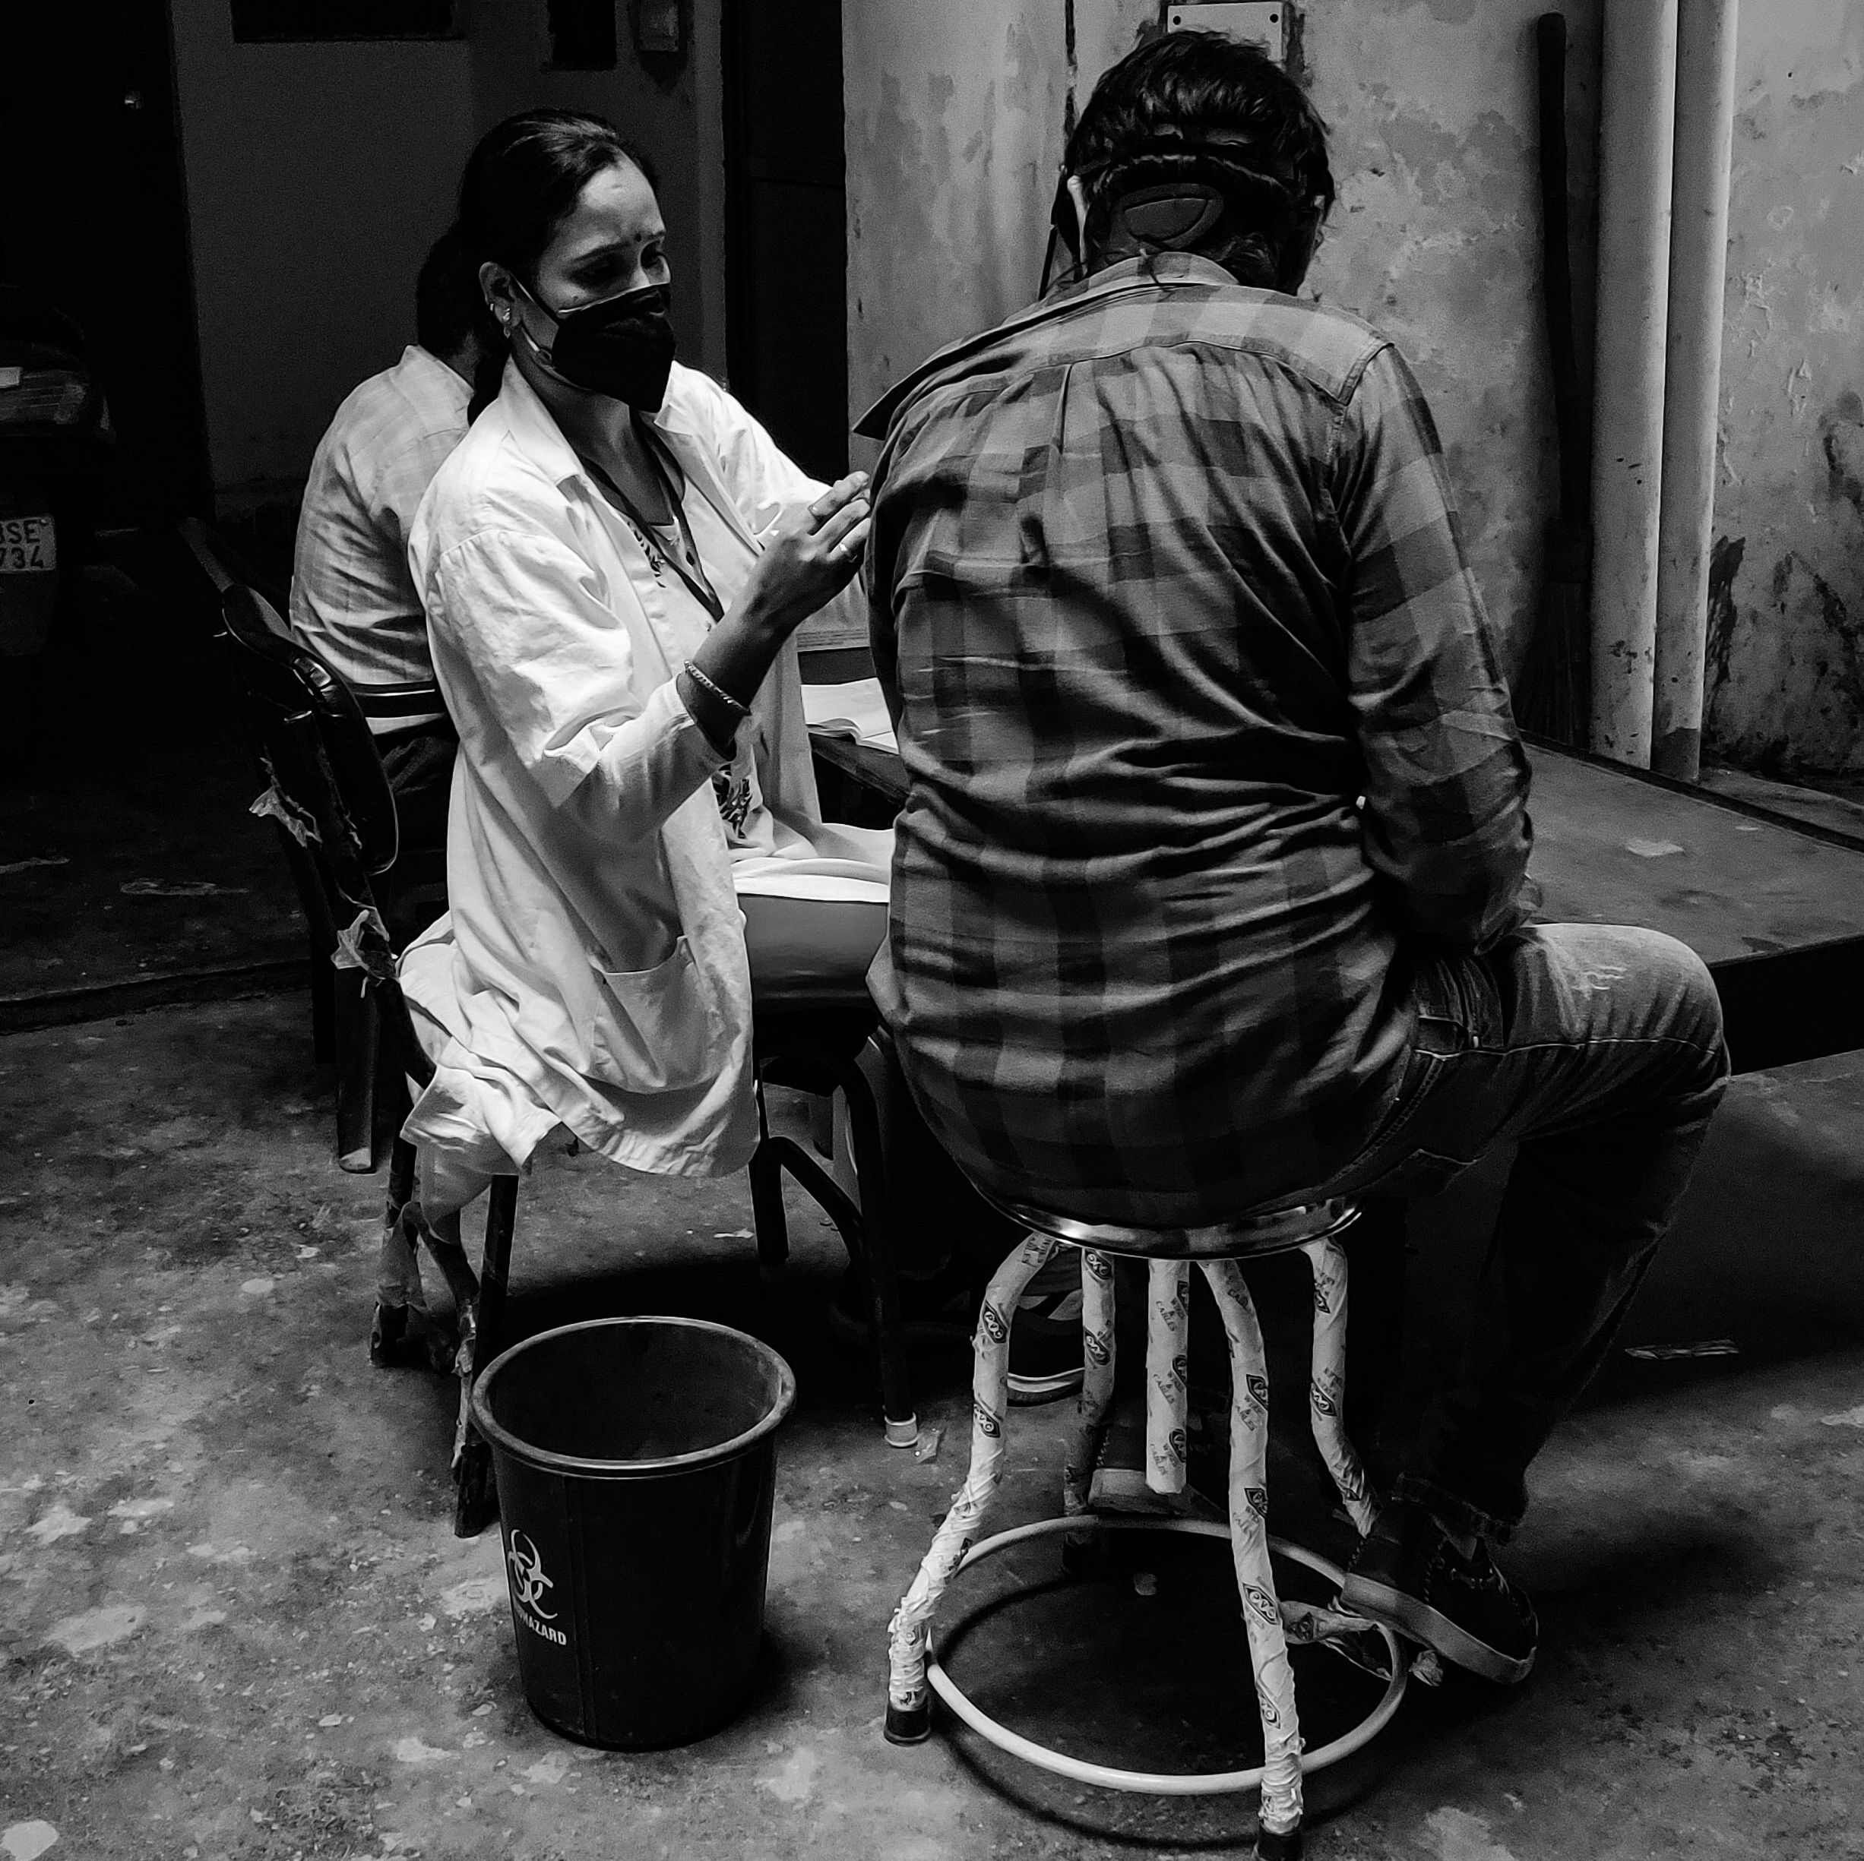
Our First Duty…
“Our first duty toward God and our fellow. beings is that of self-development. Every faculty with which the Creator has endowed us should be cultivated to the highest degree of perfection, that we may be able to do the greatest amount of good of which we are capable”— TE 137

