Slide 1
Digital Hygiene for Busy Ministry Professionals
A Daily Place for God in Every Heart and Home
2022–2027
Dwain N. Esmond, Assoc. Dir.
Ellen G. White Estate

Slide 2
Our Labor Through God’s Eyes
“Everyone who is called by my name, whom I created for my glory, whom I formed and made” (Is. 43:7)
“Therefore, whether you eat or drink, or whatever you do, do all to the glory of God” (1 Cor. 10:31)
“And whatever you do, do it heartily, as to the Lord and not to men” (Col. 3:23)
“Nothing is better for a man than that he should eat and drink, and that his soul should enjoy good in his labor. This also, I saw, was from the hand of God” (Eccl. 2:24).
“For though I am free from all men I have made myself a servant to all, that I might win the more” (1 Cor. 9:19).
“Keep watch over yourselves and all the flock of which the Holy Spirit has made you overseers. Be shepherds of the church of God, which he bought with his own blood” (Acts 20:28)

Slide 3
Our Precious Example
“My Father has been working until now, and I have been working” (John 5:12)
“Jesus said to them, ’My food is to do the will of Him who sent Me, and to finish His work’ ” (John 4:34)
“I must work the works of Him who sent Me while it is day; the night is coming when no one can work” (John 9:4).

Slide 4
The Only Right and Safe Position
“God calls for workers, not idlers; and church members are to be alive to their individual obligations under the divine administration of Him who can give the increase to all their willing, heartfelt service. Waiting, watching, working is the only right and safe position for us to occupy” (Lt 12, 1892)

Slide 5
After the Order of Christ
“Wherever you see work to be done, do your very best, after the order of Christ. Place yourselves under the discipline of God . . . In the way Christ worked, he is to work . . . Christ’s work was one of constant progress. In His life he has left us an example of how we are to labor. Constantly He went about doing good . . .” (UL 305).

Slide 6
What is Digital Hygiene?
Dr. Ed Gelbstein, 2005
Digital Hygiene is:
“The practice of cleaning up your electronic/information assets and regularly updating them. This process includes knowing how to choose your passwords, organizing files on your laptop, and adjusting the settings on your email and social media accounts, all as part of an effort to ensure greater security”— Seaglass Technology

Slide 7
A NEW DEFINITION
Spiritual Digital Hygiene is:
“The informed, intentional management of digital media to facilitate one’s God-given purpose in the personal and professional arenas of life.”
—Dwain Esmond

Slide 8
Benefits of Technology
Gives us access to more information
Saves us time
Gives us more mobility options
Communicate more efficiently
Saves money
Inspires innovation
Improves money management
Better methods of learning
Allows us to focus on ability rather than disability
Allows us eliminate many repetitious processes

Slide 9
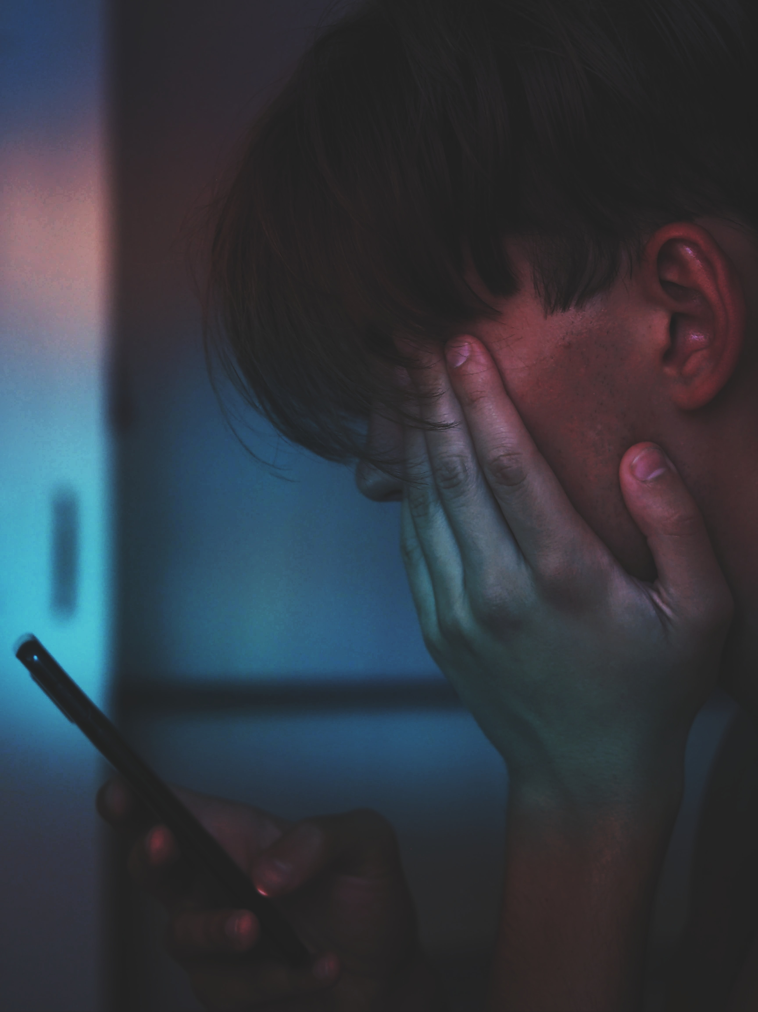
6 Negative Effects of Uniformed Uses: ATTITUDE
“Hundreds of clinical studies show that screens increase depression, anxiety, and aggression and can even lead to psychotic-like features where the video gamer loses touch with reality,” says Kardaras.
”6 Ways Digital Media Impacts the Brain” by Saga Briggs

Slide 10
6 Negative effects of Uniformed Uses: META-AWARENESS
Some studies suggest that heavy digital media use leads to a loss of cognitive control—not just a loss of attention, but also of our ability to control our mind and what we think about.
“The more you acclimate yourself to the technology and the constant flow of information that comes through it, it seems that you become less able to figure out what’s important to focus on. Instead, your mind gets attracted just to what’s new rather than what’s important.”—Nicolas Carr, The Shallows

Slide 11
6 Negative effects of Uniformed Uses: EMPATHY
In The Shallows, Carr includes a study showing that the more distracted you are, the less able you are to experience empathy.
“Distractions could make it more difficult for us to experience deep emotions,” he explains. “This kind of culture of constant distraction and interruption undermines not only the attentiveness that leads to deep thoughts but also the attentiveness that leads to deep connections with people.”

Slide 12
6 Negative effects of Uniformed Uses: THOUGHT
According to a new study published in the proceedings of the ACM Conference on Human Factors in Computing Systems, reading on digital platforms might make you “more inclined to focus on concrete details rather than interpreting information more abstractly.”

Slide 13
6 Negative effects of Uniformed Uses: MEMORY
“Our research shows that as we use the Internet to support and extend our memory, we become more reliant on it. As more information becomes available via smartphones and other devices, we become progressively more reliant on it in our daily lives.”—Researchers at Univ. Calif., Univ. of Ill.
We are becoming less likely to form memories.

Slide 14
6 Negative effects of Uniformed Uses: ATTENTION
“What psychologists and brain scientists tell us about interruptions is that they have a fairly profound effect on the way we think. It becomes much harder to sustain attention, to think about one thing for a long period of time, and to think deeply when new stimuli are pouring at you all day long.”—Nicolas Carr, The Shallows

Slide 15
Spiritual Digital Hygiene for Ministry Professionals
File Management:
Declutter your devices by removing unnecessary files and apps.
Reorganize your most-used apps and categorize them into easy-to-access folders.
Embrace cloud computing by storing your files and folders via online storage.

Slide 16
Spiritual Digital Hygiene for Ministry Professionals
Social Media:
Remove the social media accounts that you no longer use or are easily distracted by.
Find offline alternatives to social media, prioritize in-person socialization
Set an amount of time to be on and then stop
Unfollow people with whom you share little common interests

Slide 17
Spiritual Digital Hygiene for Ministry Professionals
Customize Your Desktop:
Add only necessary Apps and Software programs
Install software and apps at once using programs such as Ninite
At end of day, close all open tabs on your online browser

Slide 18
Spiritual Digital Hygiene for Ministry Professionals
Email:
Delete unused or unwanted emails once a day
Unsubscribe from useless newsletters.
Make an effort to check your emails at specific times, removing the temptation to continuously check

Slide 19
Spiritual Digital Hygiene for Ministry Professionals
Mobile Devices:
Turn off notifications that you waste too much time checking.
Hide your phone away or put it in a drawer when you do not need to use it
Remove contacts and numbers that you don’t recognize or need
Track your daily usage with tools such as the Moment app

Slide 20
Spiritual Digital Hygiene for Ministry Professionals
Mobile Devices:
Slow your response to less urgent notifications
During your commute, turn off your phone
Do not start or end your day with your phone
Use your phone for its purpose, not as a pacifier

Slide 21
Spiritual Digital Hygiene for Ministry Professionals
Digital Detox:
Leave the digital world for 1 day per week, bi-weekly, or monthly
Do all digital chores at a specific time, if possible
Set and time to leave the digital world each day
Limit yourself to 1 screen at a time.
Make a list of hobbies you’d like to try, Get Physical
Set Aside time for Prayer and Reflection

Slide 22
“Keep your heart with all diligence, For out of it spring the issues of life” (Proverbs 4:23).

